Slide 1
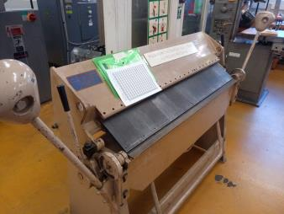
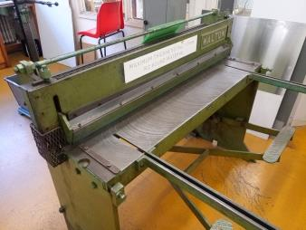
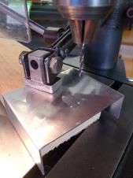
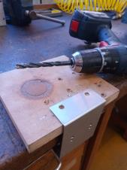
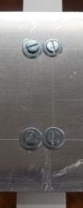
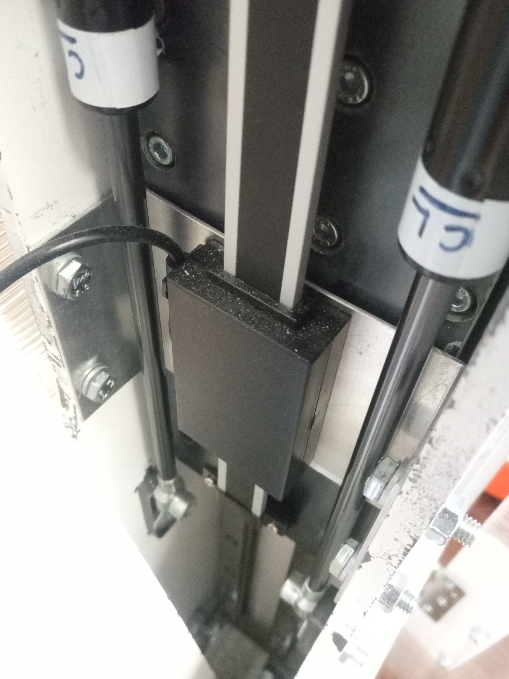
167mm
4x 8mm holes, vertical locations marked at 31mm from underside of bracket after folding complete
4x 4mm holes for mounting linear scale carriage, centred on plate
50mm
40mm
80mm
9mm
Fold lines, supported edge shown by hatch
35mm
101 – 2 – 2 = 97mm
35mm
A
B
C
D
E
F

